Slide 1
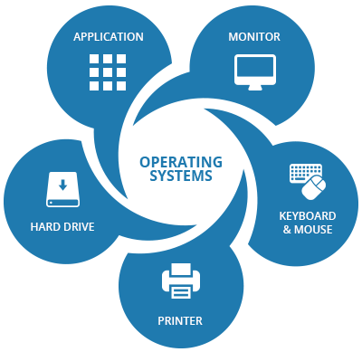
OPERATING SYSTEM
A PRESENTATION BY “ORBIT”
ANAM MD ISFAQ
DIP FAZLA IMAM
RAHMAN MOHAIMENUR
SHIFA JANNATUN NUR
KANTA MARIA AKTER

Slide 2
An operating system is a powerful, and usually large, program that controls and manages the hardware and other software on a computer.
OPERATING SYSTEM
LINUX
WINDOWS
MAC
EXAMPLE
JAVA
ANDROID

Slide 3
WHAT OPERATING SYSTEM DOES?
Recognizing input from the keybord
Sending output to the display screen
Keeping track of files on the storage drives

Slide 4
MULTI-USER
MULTIPROCESSING
MULTITHREADING
REALTIME
MULTITASKING
CLASSIFICATION OF OPERATING SYSTEM

Slide 5
WINDOWS: Windows Microsoft Windows is a family of operating systems for personal and business computers. Windows dominates the personal computer world, offering a graphical user interface (GUI), virtual memory management, multitasking, and support for many peripheral devices.
MOST POPULR DESTOP OPERATING SYSTEM

Slide 6
Mac: Mac OS is the official name of the Apple Macintosh operating system. Mac OS features a graphical user interface (GUI) that utilizes windows, icons, and all applications that run on a Macintosh computer have a similar user interface.

Slide 7
Linux: Linux is a freely distributed open source operating system that runs on a number of hardware platforms. The Linux kernel was developed mainly by Linus Torvalds and it is based on Unix.

Slide 8
MOBILE OPERATING SYSTEM
ANDROID
APPLE OS

Slide 9
ANDROID
The android mobile operating system is Google's open and free software stock that includes an operating system and also key application for use on mobile devices including smartphones updates for the open source android mobile operating system.

Slide 10
APPLE OS
Apple OS was originally developed for use on it’s IPHONE devices . Now the mobile operating system is referred to as IOS and is supported on number of apple devices including the IPHONE, IPAD.

Slide 11
CONCLUSION: To conclude I do believe the computer is here to stay and therefore it will require an os and has started elsewhere in this report and the os represent the persona of the computer .For this reason the computer and its persona will continue to evolve , as we evolve and our expectation grows and by GORDON MOORE’S LAW – Bearing the silicon chip in mind about every two years we can expect dramatic changes with an equal dramatic rein on cost.

Slide 12
It enables a computer user to come to understand how to approach a particular platform. Without operating system the computers can not run the application and we can not do work in the computer. Therefore operating system is very important in computer.

Slide 13
THANK YOU

